Slide 1
Presentation of programming and algorithm
Presented by:
Bipasha Lamsal
Topic:
About Linear Search and Binary Search

Slide 2
Linear search
This algorithm works sequentially repeating through the entire collection or list from one end until the target element is found.
If the targeted element is found then it returns it’s index, and if element is not found then it returns -1. Linear search is also called as sequential search algorithm.
The time complexity of linear search in the best case, average case, and worst case are:
Best Case Complexity: In Linear Search, best case occurs when the element we are finding is at the first position of the array or list. The best-case time complexity of linear search is O(1):
Average Case Complexity: On average, the target element will be somewhere in the middle of array. The average case time complexity of linear search is O(n).
Worst Case Complexity- In Linear search, the worst case occurs when the element we are looking is present at the end of the array. The worst case in linear search could be when the target element is not present in the given array and we have to crisscross the entire array. The worst case time complexity of linear search is O(n).

Slide 3
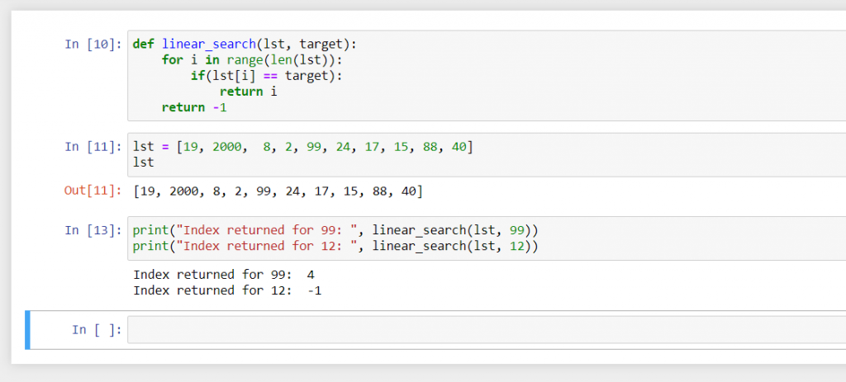
Code related to the Linear search
:
Source: https://www.askpython.com/wp-content/uploads/2021/03/linear-search-python-example-1024x463.png

Slide 4
Binary Search:
A Binary search is an advanced type of algorithm that finds and fetches data from a sorted list of items. It works by dividing the data in the list to half until the required value is located and displayed to the user in the search result.
Binary search can be implemented only on a sorted list of items. If the elements are not sorted already, we need to sort them first.
These algorithms use the “divide and conquer” technique to find the value's position.
The advantages of Binary Search are:
Binary search works efficiently on sorted data no matter the size of the data.
Instead of performing the search by going through the data in a sequence, the binary algorithm randomly accesses the data to find the required element. This makes the search cycles shorter and more accurate.

Slide 5
During Binary search, the list is split into two parts to get the middle element: there is the left side, the middle element, and the right side. The left side contains values smaller than the middle element and the right side contains values that are greater than the middle element. This method uses a sorted list to work. A sorted list has its items arranged in a particular order. To make search efficient for binary search, the values in the list have to be arranged in the right order to satisfy the process of search. If a list has its values mixed up, it has to be sorted by a sorting algorithm before you perform the search.
Binary Search Complexity:
The time complexity of binary search in python is better than linear search because we do not need to search over the entire array. We smartly divide the array into smaller sub-arrays and get our answer. So, binary search is a faster and more efficient algorithm.

Slide 6
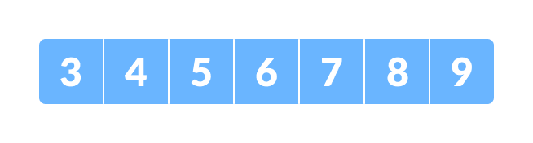
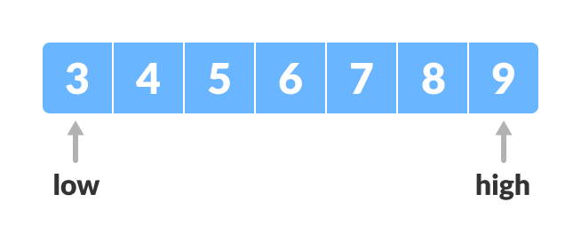
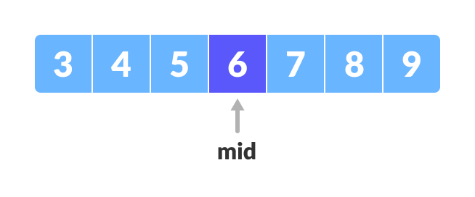
1) The array in which searching is to be performed is:
Initial array
Let x=4 be the element to be searched.
2) Set two pointers low and high at the lowest and the highest positions respectively.
3) Find the middle element mid of the array i.e. arr[(low+ high)/2]=6

Slide 7
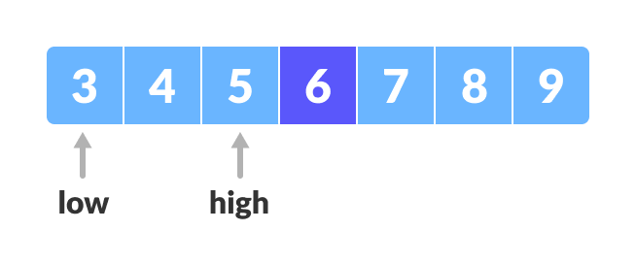
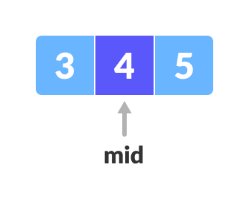
4) If x == mid, then return mid. Else, compare the element to be searched with m. 5) If x < mid, the search moves to the left side because the values are less than the middle element. The position of the middle element shifts to the left by 1. New position = index(middle element) – 1. A new search begins and the search ends at that new position and it takes all the values before it. This is done by setting high to [high = mid - 1]. 6) If x >mid, the search moves to the right side. The position of the middle element shifts to the right by 1. New position= index(middle element)+1. A new search begins and the search ends at that new position and it takes all the values after it. This is done by setting low to [low=mid+1]. 7) Repeat step 3 to 6, until low meets high. 8) x=4 is found. (x=mid) https://www.programiz.com/dsa/binary-search

Slide 8
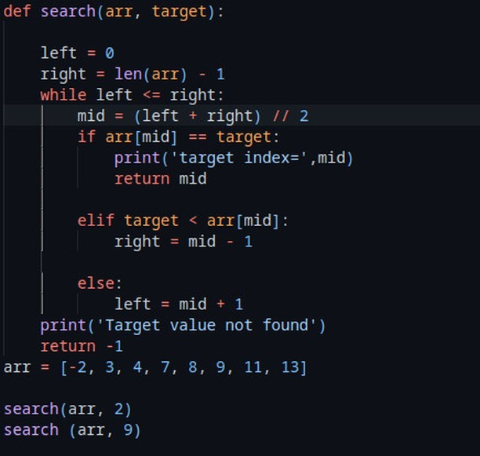
://www.geeksforgeeks.org/python-program-for-binary-search/

